Slide 1



Mentorness
Hotel
Reservation
Analysis
BATCH NAME = MIP-DA-10
Ushashree Shripati

Slide 2
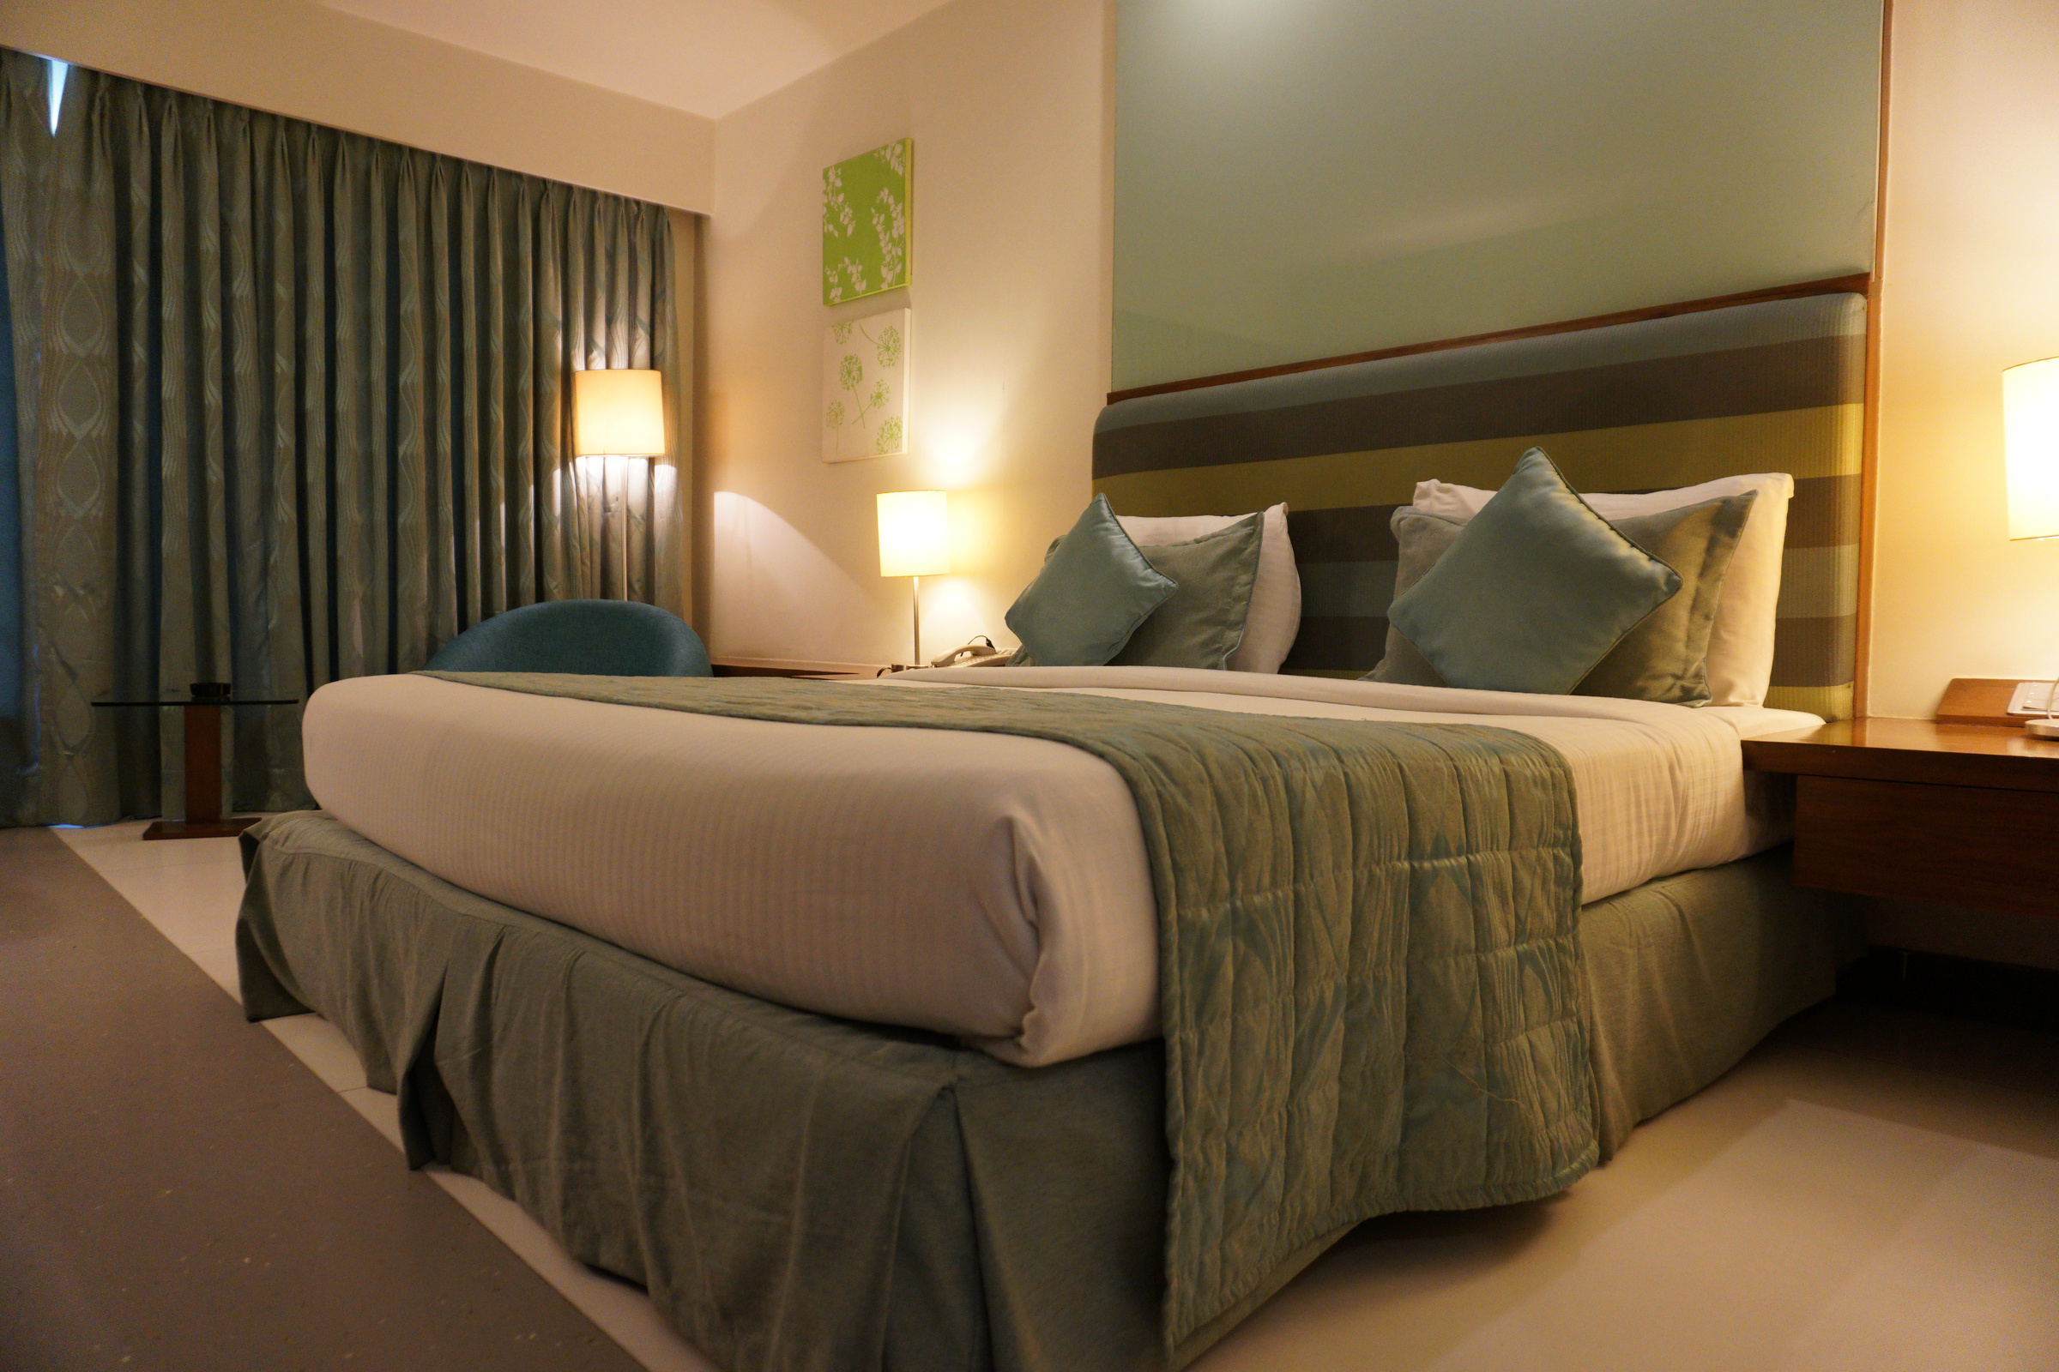
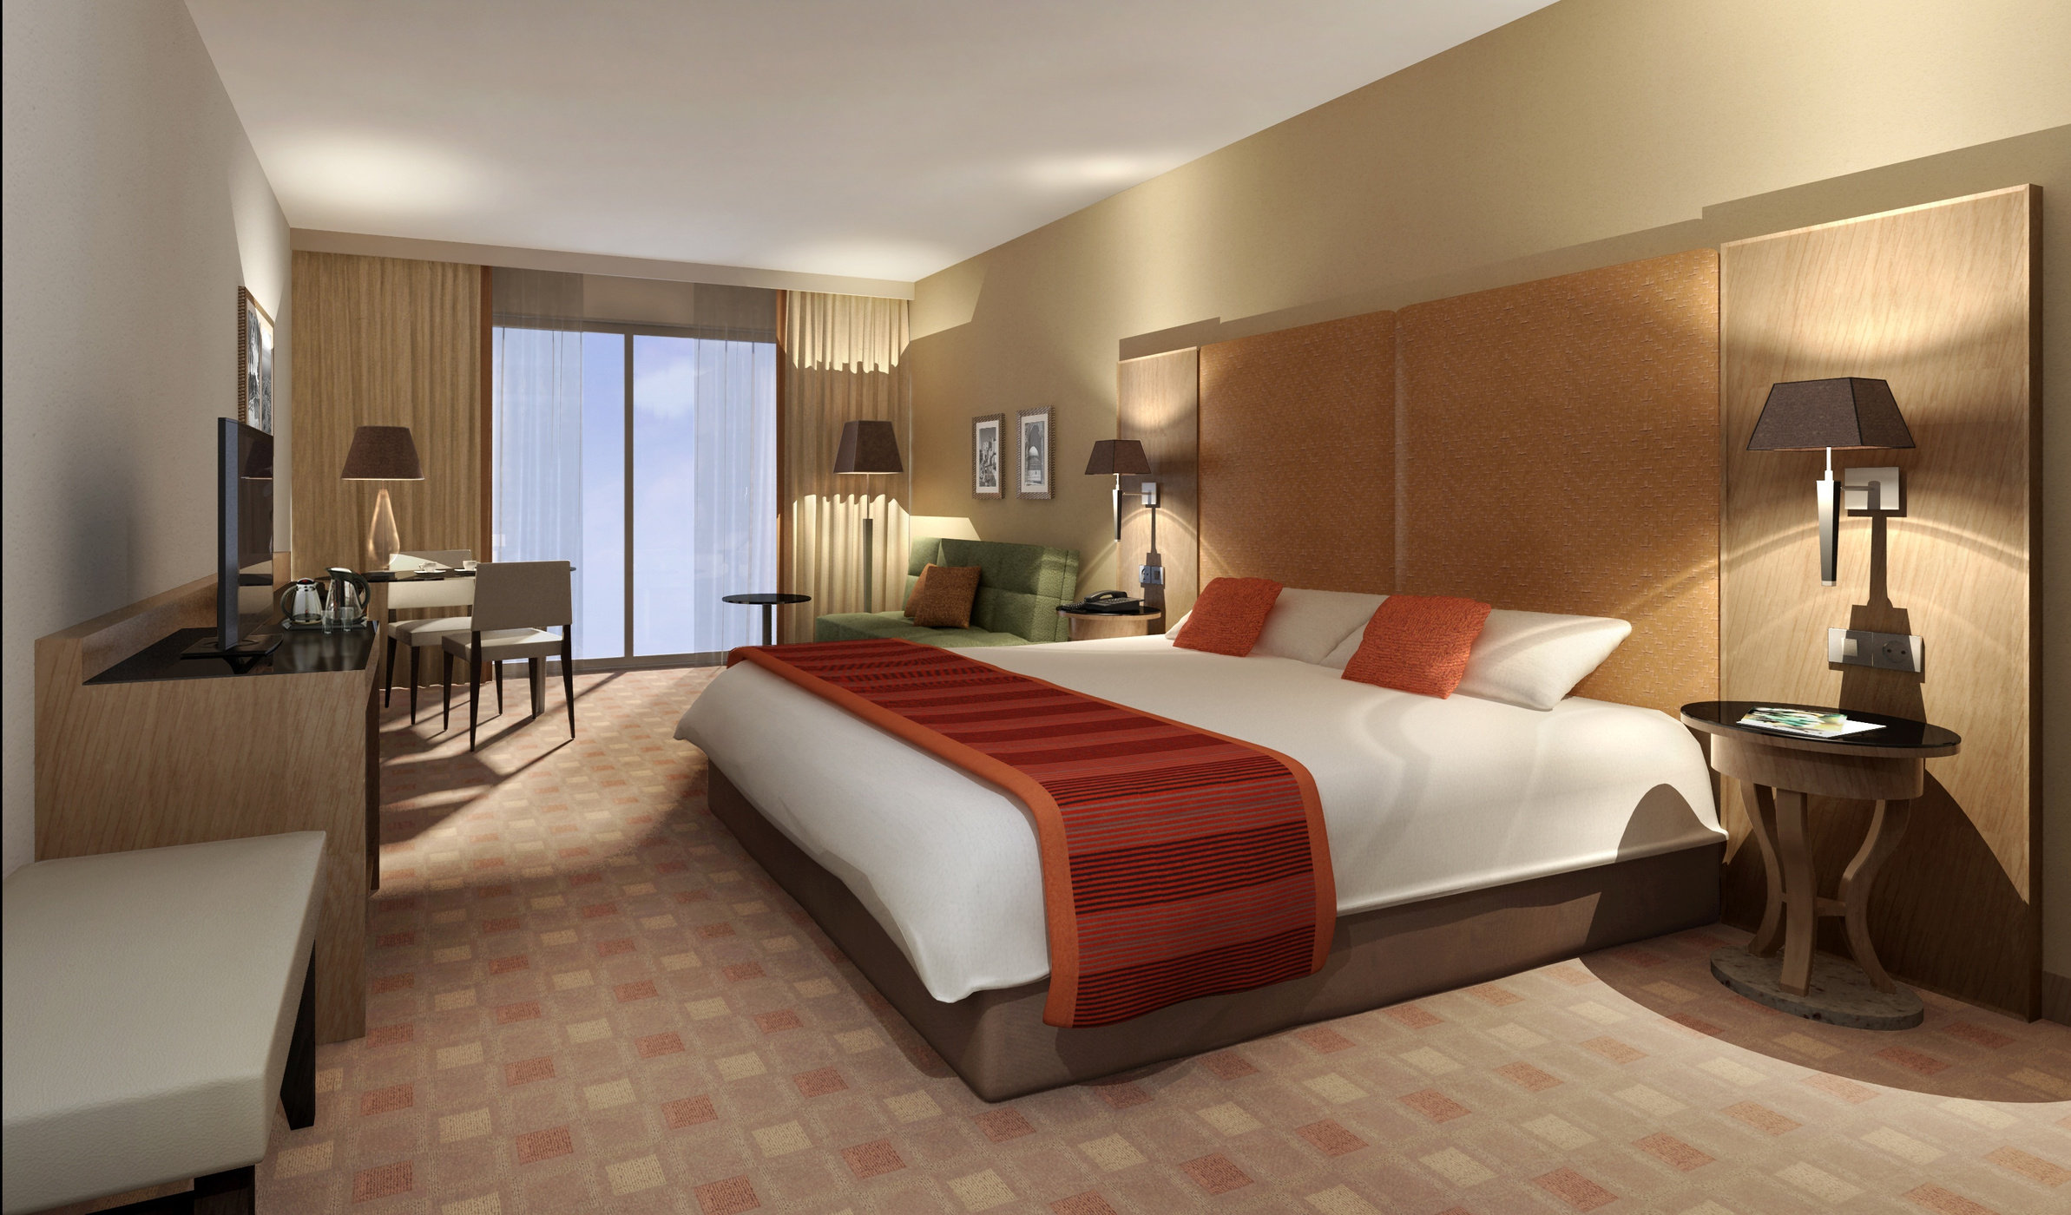
Mentorness
Agenda
Overview /Introduction
Dataset Overview
SQL Queries
Conclusion

Slide 3
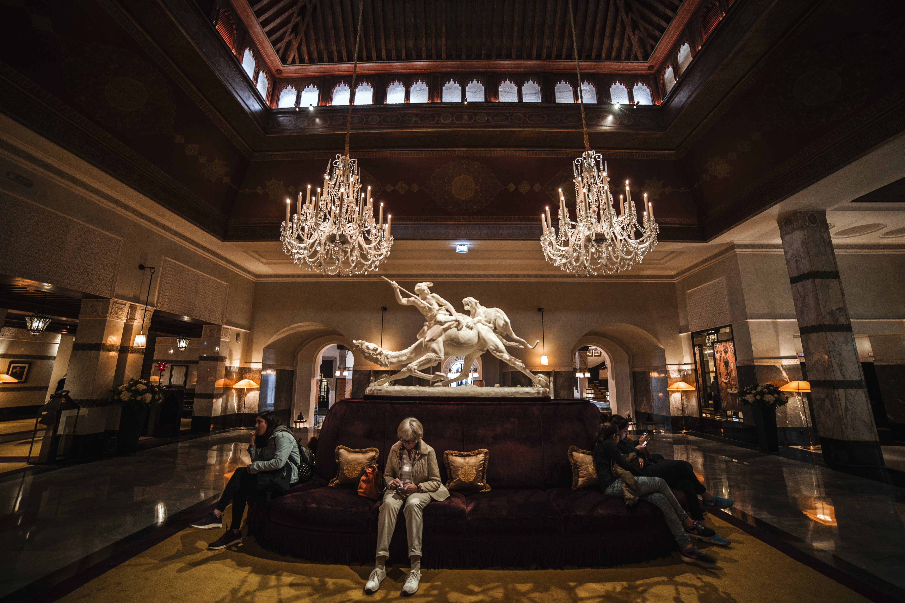
Mentorness
Overview of Hotel Reservation Analysis
The hotel industry relies on data to make informed decisions and provide a better guest experience. In this internship, worked on a hotel reservation dataset to gain insights into guest preferences, booking trends, and other key factors that impact the hotel's operations. By using SQL to query and analyze the data, as well as answered specific questions about the dataset.

Slide 4


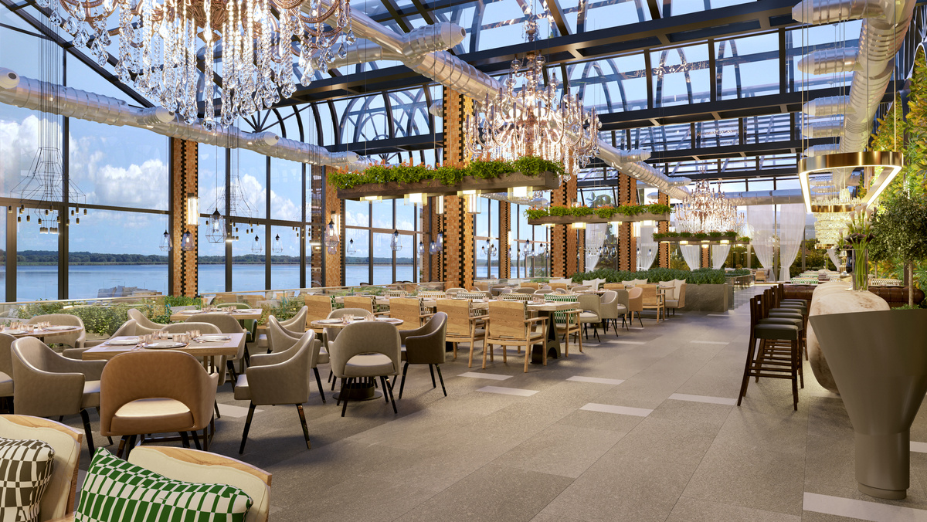

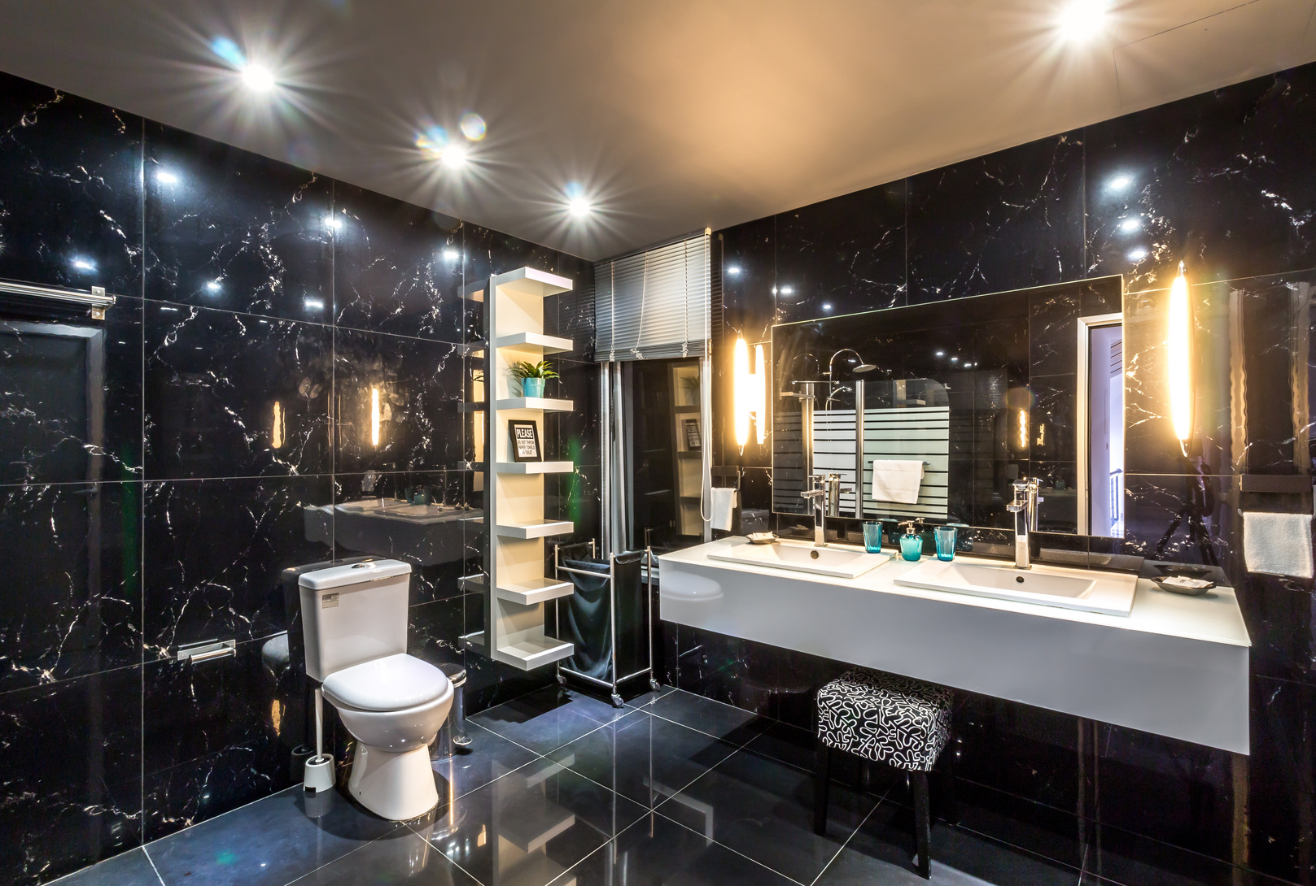

• no_of_weekend_nights: The number of nights in the reservation that fall on weekends.
• no_of_week_nights: The number of nights in the reservation that fall on weekdays.
• type_of_meal_plan: The meal plan chosen by the guests.
• room_type_reserved: The type of room reserved by the guests.
• lead_time: The number of days between booking and arrival.
• arrival_date: The date of arrival.
• market_segment_type: The market segment to which the reservation belongs. • avg_price_per_room: The average price per room in the reservation.
• booking_status: The status of the booking.
Mentorness
Dataset
Overview
The dataset includes the following columns:
• Booking_ID: A unique identifier for each hotel reservation.
• no_of_adults: The number of adults in the reservation.
• no_of_children: The number of children in the reservation.

Slide 5

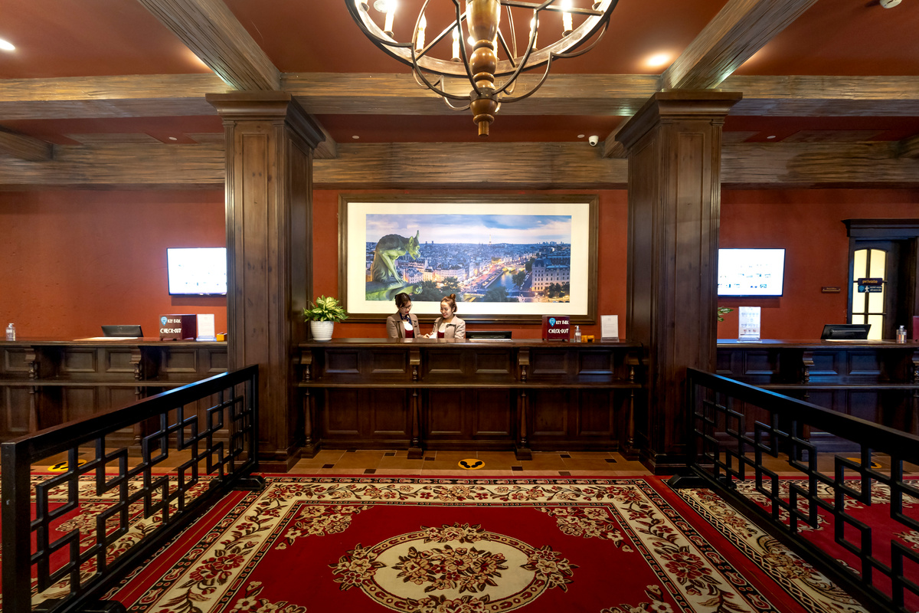
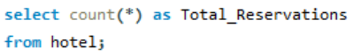
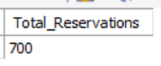

SQL Query 1
Mentorness
What is the total number of reservations in the dataset?
Read More

Slide 6
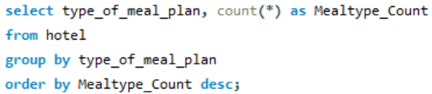
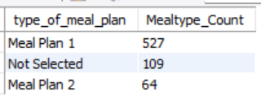
Mentorness
SQL Query 2
Which meal plan is the most popular among guests?
Read More

Slide 7
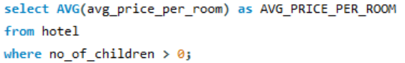
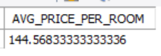
SQL Query 3
Mentorness
What is the average price per room for reservations involving children?
Read More

Slide 8
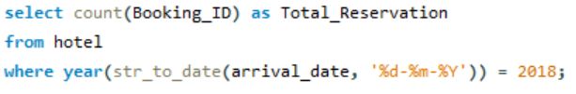
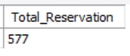
Mentorness
SQL Query 4
How many reservations were made for the year 2018?
Read More

Slide 9
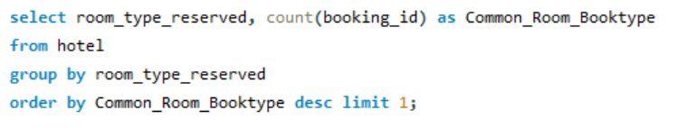
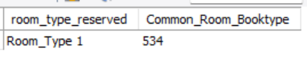
SQL Query 5
Mentorness
What is the most commonly booked room type?
Read More

Slide 10
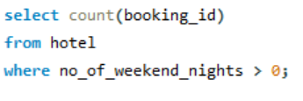
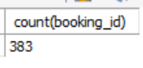
Mentorness
SQL Query 6
How many reservations fall on a weekend (no_of_weekend_nights > 0)?
Read More

Slide 11
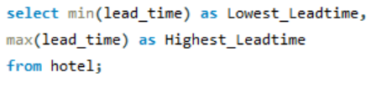
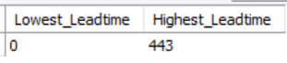
SQL Query 7
Mentorness
What is the highest and lowest lead time for reservations?
Read More

Slide 12
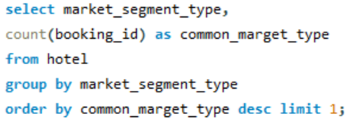
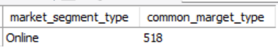
Mentorness
SQL Query 8
What is the most common market segment type for reservations?
Read More

Slide 13
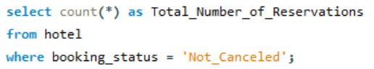
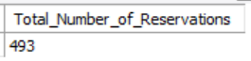
SQL Query 9
Mentorness
How many reservations have a booking status of "Confirmed"?
Read More

Slide 14
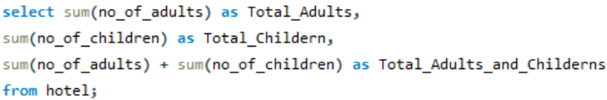
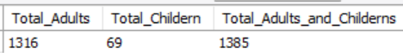
Mentorness
SQL Query 10
What is the total number of adults and children across all reservations?
Read More

Slide 15
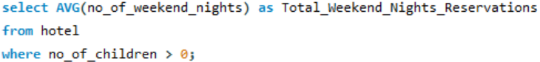
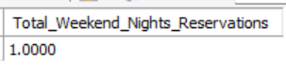
SQL Query 11
Mentorness
What is the average number of weekend nights for reservations involving children?
Read More

Slide 16
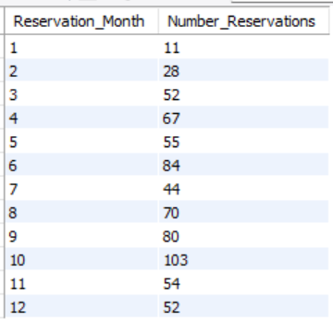
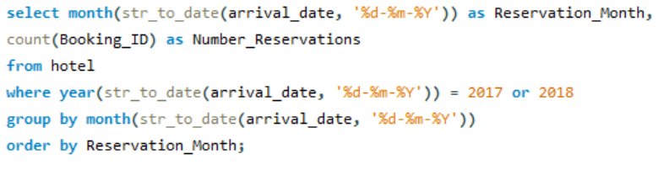
Mentorness
SQL Query 12
How many reservations were made in each month of the year?
Read More

Slide 17
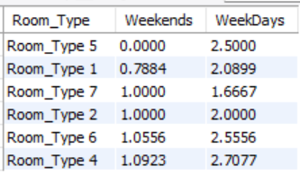
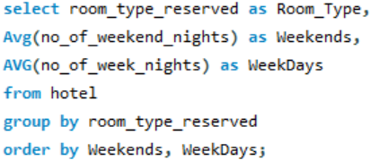
Mentorness
SQL Query 13
What is the average number of nights (both weekend and weekday) spent by guests for each room type?
Read More

Slide 18
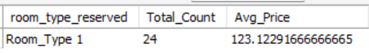
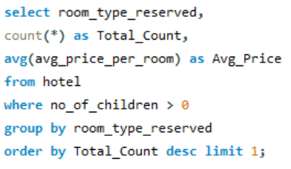
Mentorness
SQL Query 14
For reservations involving children, what is the most common room type, and what is the average price for that room type?
Read More

Slide 19
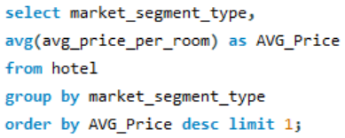
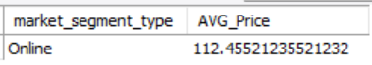
SQL Query 15
Mentorness
. Find the market segment type that generates the highest average price per room.
Read More

Slide 20
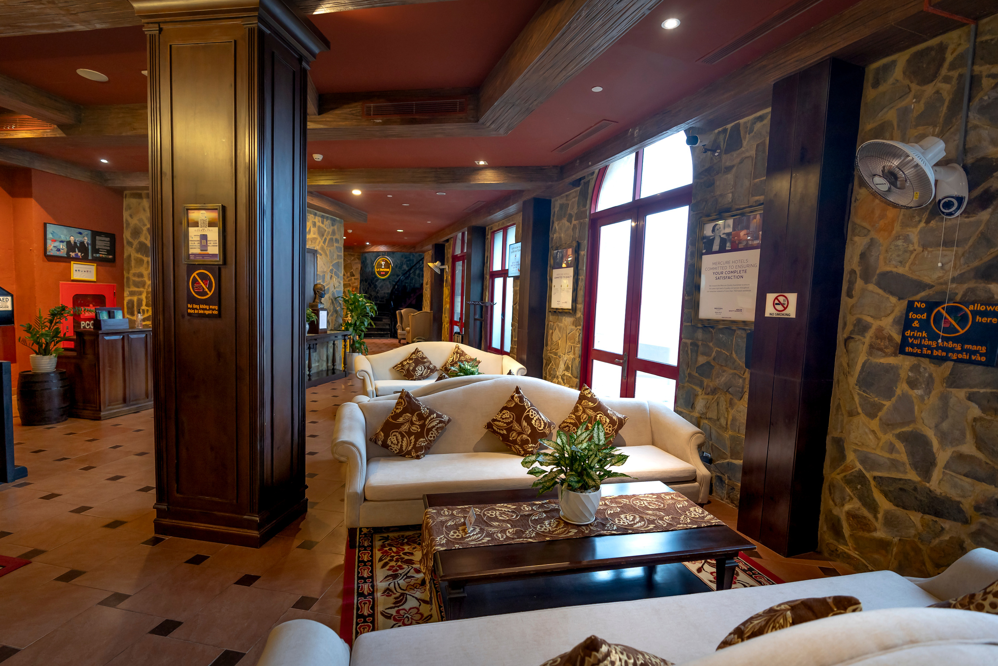
Conclusion
Mentorness
Popular Meal Plans and Room Types: Meal Plan 1 and Room Type 1 were the most preferred choices among guests.
Family Reservations: Families tend to book rooms at a slightly higher average price, with Room Type 4 being the most common choice.
Lead Time Variability: The lead time for reservations varied significantly, from last-minute bookings to those planned nearly a year in advance.
Market Segment Analysis: The Online market segment not only had the highest number of reservations but also generated the highest average room prices.

Slide 21





Mentorness
Contact
Information
Email
ushashripati41997@gmail.com
Website
https://sites.google.com/view/ushashree
Social Media
https://www.linkedin.com/in/ushashreeshripati/
Phone Number
8329317365

Slide 22


Mentorness
Thank You

